Slide 1

Trip Planner Using Tkinter
Siddhi Patwardhan 22107033
Radhika Pradhan 22107005
Gauri Salvi 22107014
Tejas Patil 22107024
Project Guide
Prof. Poonam Pangarkar

Slide 2
Outline
Introduction
Literature Survey of the existing systems
Limitations of the existing systems
Problem statement
System Design
Technologies
Implementation
Conclusion
References

Slide 3
Introduction
With the increasing accessibility of travel and the rise of global tourism, effective trip planning has become essential for travelers to maximize their experiences while minimizing potential hassles and uncertainties.
Our Technology has revolutionized the way people plan their trips, offering a plethora of digital tools and platforms designed to streamline the planning process, enhance convenience, and optimize travel experiences.
These digital or physical tools act as your travel companions, guiding you through every stage of the journey. From researching destinations and creating a customized itinerary.
Budget-conscious travelers can utilize price comparison tools and discount alerts to find the best deals on flights and accommodations.

Slide 4
Literature Survey of the existing system
Author | Year | Title | Result
Hua-Jun Hong, Shuming Shi, Yun-Feng Zhang | 2018 | An Effective and Efficient Tour Recommendation System [1] | Proposes an effective and efficient tour recommendation system that considers user preferences, travel constraints, and real-time location data. It generates personalized tour plans and suggests nearby amenities like restaurants, hotels, and attractions.

Slide 5
.
Author | Year | Title | Result
Xiang Wang, Yu Zheng, Hsun-Ping Hsieh, Yong Yu | 2016 | Learning Travel Recommendations with Local Intent and Global Context from User-Generated GPS Trajectories [2] | Presents a travel recommendation system that learns from user-generated GPS trajectories to provide personalized recommendations considering both local intents and global context. It includes a budget calculation component, which estimates travel expenses based on historical data and user preferences.

Slide 6
.
Author | Year | Title | Result
Junqi Jin, Qing Zhang, Qingsheng Zhu, Xiaoyong Du, Yanchun Zhang | 2019 | A Personalized Trip Planning System Based on User Interest Ontology [3] | Proposes a personalized trip planning system based on user interest ontology, considering user preferences and semantic relationships between attractions. It generates customized itineraries and offers suggestions for attractions, restaurants, and accommodations.

Slide 7
.
Author | Year | Title | Results
Tiantian Liu, Yu Zheng, Xing Xie, Yukun Chen | 2014 | Personalized Travel Sequence Recommendation on Multi-Source Big Social Media [4] | Introduces a personalized travel sequence recommendation system based on multi-source big social media data. It utilizes user preferences, historical trajectories, and social connections to generate personalized travel itineraries. It suggests sequences of attractions and activities tailored to individual preferences and interests.

Slide 8
Limitations of existing systems
1) Limited Availability of Data: Trip planners heavily rely on available data such as transportation schedules, accommodation options, and tourist attractions. In some regions or for certain activities, data may be sparse or outdated, limiting the planner's effectiveness.
2) Dependency on Internet Connection: Many trip planners require a constant Internet connection to access real-time data, maps, and updates. This can be a limitation in areas with poor connectivity or during travel in remote locations where internet access is limited.
3) Inaccuracy of Data: Despite efforts to maintain accuracy, data used by trip planners may occasionally be outdated or incorrect. This can lead to inaccurate itinerary suggestions, such as recommending closed attractions or outdated transportation options.
4) Complex Travel Scenarios: Trip planners may struggle to handle complex travel scenarios involving multiple destinations, layovers, transportation modes, and preferences. Users with intricate travel plans may find it challenging to accurately represent their itinerary using the planner.

Slide 9
Problem statement
Lack of Personalization: Trip planner applications often fail to provide personalized recommendations based on user preferences, travel history, and interests.
Limited Customization Options: Users encounter difficulties in customizing their travel itineraries according to their preferences, such as specific destinations, activities, accommodations, and transportation modes.
Inefficient Trip Planning Process: Trip planning processes are often time-consuming and cumbersome, requiring users to gather information from multiple sources and manually organize their travel plans.
Fragmented Information Sources: Users encounter challenges in accessing and consolidating information from various sources, including travel websites, review platforms, and booking engines. This fragmentation complicates the trip planning process and increases the likelihood of overlooking relevant details or encountering discrepancies.

Slide 10
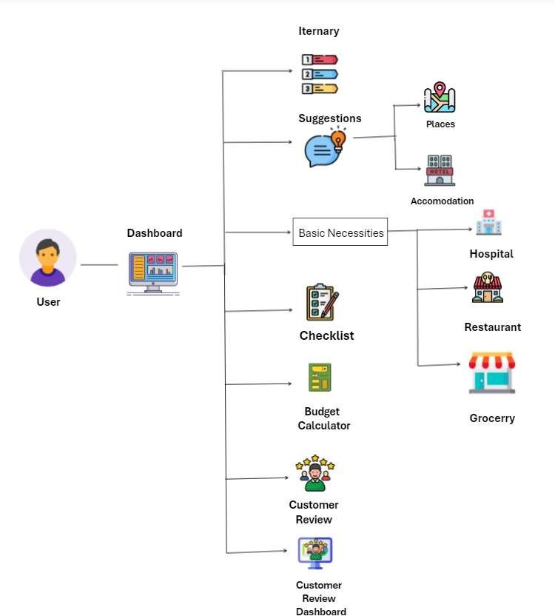
System Design

Slide 11
Technologies
Sr No | Components | Sub-Component | Specification
1. | Operating System | Windows | Windows 11
2. | Languages | Python | Python 3.1.2
3. | Backend | SQL | SQL 8.0.34
4. | IDE | PyCharm Community Edition MySQL | PyCharm Community Edition 2023.3.4 MySQL 8.3.0
5 | Libraries | PIL Web browser MySQL Connector Tkinter | PIL 10.2.0 MySQL connector 8.3.0 Tkinter Tk 8.6

Slide 12
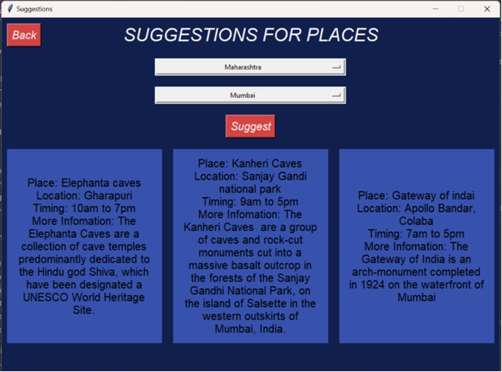
Implementation Suggestion window

Slide 13
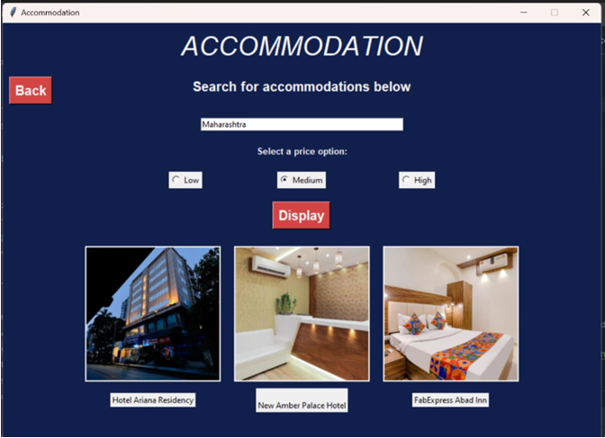
.
Accommodation window

Slide 14
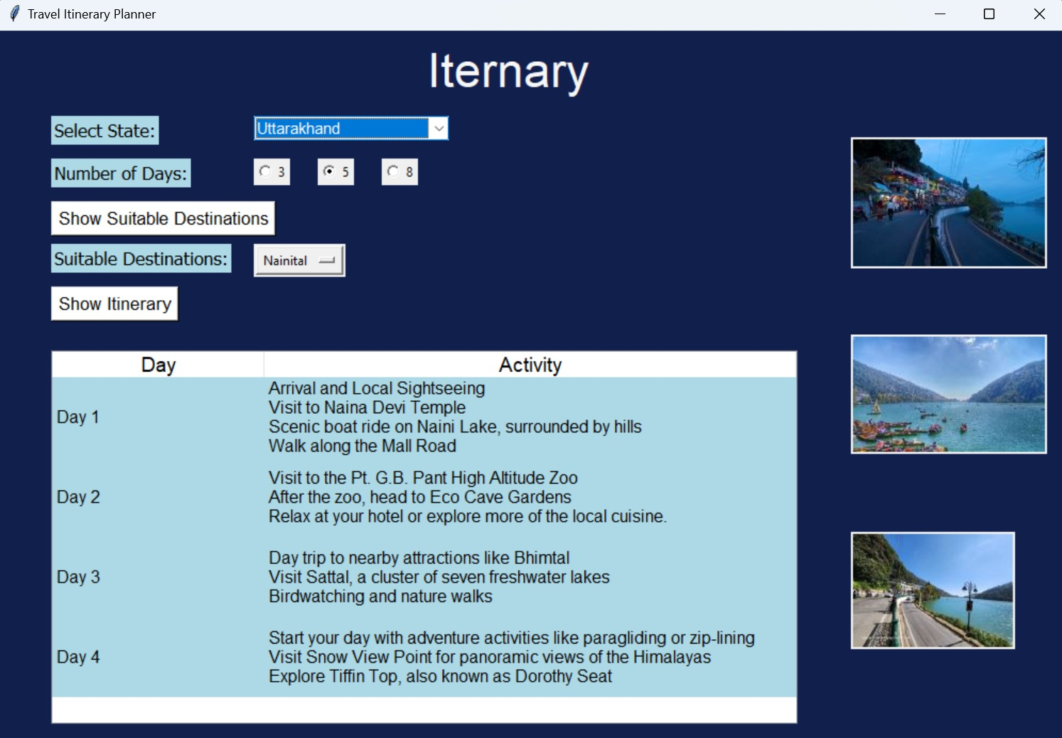
Iternary Window

Slide 15
Conclusion
In response to the expanding travel industry, there's a need for modernized systems addressing data storage, user flow, and aesthetics. This proposed system offers a user-friendly interface with simplified processes, attractive visuals, and efficient management of travel plans. By streamlining booking and preventing double bookings, it enhances user experience and supports the economies of various countries.

Slide 16
References
[1] Junqi Jin, Qing Zhang, Qingsheng Zhu (2019). “This paper proposes a personalized trip planning system based on user interest ontology, generating customized itineraries and suggestions for attractions, restaurants, and accommodations."
[2] Hua-Jun Hong, Feng Zhang (2018). " It generates personalized tour plans and suggests nearby amenities like restaurants, hotels, and attractions.
[3] Xiang Wang, Yu Zheng (2016). " It includes a budget calculation component, which estimates travel expenses based on historical data and user preferences."
[4] Tiantian Lu, Yu Zheng (2014). " It utilizes user preferences, historical trajectories, and social connections to generate personalized travel itineraries."

Slide 17
Thank You...!!

